Slide 1
A Matter of Heart: Fitting a Heart Failure Dataset for Data Visualization and Analysis
Phil Yeung, PharmD, MSP, MAS-CR
Graduate Student, MS Health Data Science Program
KUMC

Slide 2
Agenda
Background
Epidemiology and impact of heart failure (HF)
HF Dataset
Data collected
Data structure and coding
Visualization of key clinical and demographic characteristics
Visual Data and Statistics Analyzer
Purpose and interface of user inputs
Outputs
Summary statistics
Simple regression plots by group
Facilitate creation of “Table 1”
Visualization of the final, interactive ANCOVA model from the HF dataset

Slide 3
Background Epidemiology and impact of heart failure (HF)
Literatures show substantial healthcare service and cost are associated with HF in terms of hospital admission and mortality. Based on the 2021 American Heart Association Statistical Update , CHF affects about 6 million (about 1.8%) of the total US population (332, 601 million at 2020 Census)¹
In older adults (age >= 65 years old), the prevalence is estimated to increase from 4.3% in 2012 to 8.5% in 2030¹
In patients with DM, the prevalence of HF is between 9% and 22%, which is 4 times higher than the general population, and the prevalence is even higher in patients with DM who are ≥60 years old²
¹Roger VL. Epidemiology of Heart Failure: A Contemporary Perspective. Circ Res. 2021;128(10):1421-1434. https://www.ahajournals.org/doi/full/10.1161/CIRCRESAHA.121.318172
²Type 2 Diabetes Mellitus and Heart Failure: A Scientific Statement From the American Heart Association and the Heart Failure Society of America. Circulation. 2019;140(7):e294-e324.

Slide 4
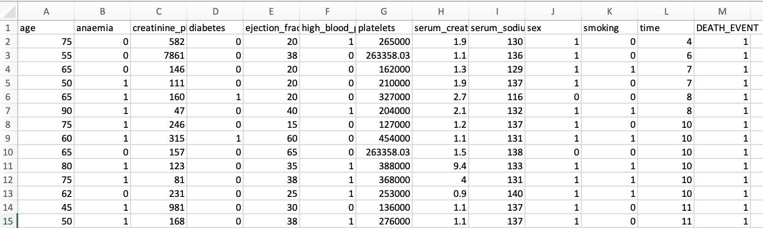
HF Dataset Data collected
The dataset comprises of medical records of 299 heart failure patients at the Faisalabad Institute of Cardiology and at the Allied Hospital in Faisalabad (Punjab, Pakistan), during April–December 2015
All patients have left ventricular systolic dysfunction and were classified as classes III or IV heart failure based on of New York Heart Association (NYHA)
All patients have recorded ejection fraction which is an important measurements of cardiac function in chronic HF patients
Two peer-reviewed publications were developed by using this dataset:
Tanvir Ahmad, Assia Munir, Sajjad Haider Bhatti, Muhammad Aftab, and Muhammad Ali Raza: "Survival analysis of heart failure patients: a case study". PLoS ONE. 2017;12(7): 0181001
Davide Chicco, Giuseppe Jurman: "Machine learning can predict survival of patients with heart failure from serum creatinine and ejection fraction alone". BMC Medical Informatics and Decision Making. 2020; 20:16 (2020).
https://archive.ics.uci.edu/ml/datasets/Heart+failure+clinical+records

Slide 5
HF Dataset Data Structure and Coding of 13 Clinical Attributes
Numerical Data
Age: age of the patient (years)
Creatinine phosphokinase (CPK): level of the CPK enzyme in the blood (mcg/L)
Ejection fraction: percentage of blood leaving the heart at each contraction (percentage)
Platelets: platelets in the blood (kiloplatelets/mL)
Serum creatinine: level of serum creatinine in the blood (mg/dL)
Serum sodium: level of serum sodium in the bltime: follow-up period (days) ood (mEq/L)
Categorical Data (Factor)
Anaemia: decrease of red blood cells or hemoglobin (Yes= 1, No= 0)
High blood pressure: if the patient has hypertension (Yes= 1, No= 0)
Diabetes: if the patient has diabetes
(Yes= 1, No= 0)
Sex: woman (1) or man (0)
Smoker: if the patient smokes or not
(Yes= 1, No= 0)
Death event: if the patient deceased during the follow-up period
(Yes= 1, No= 0)

Slide 6
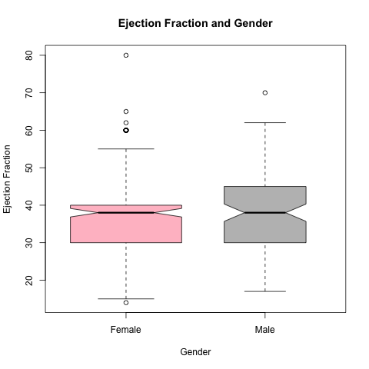
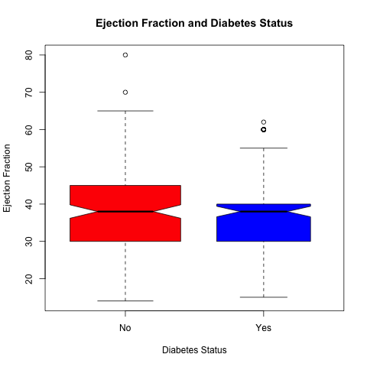
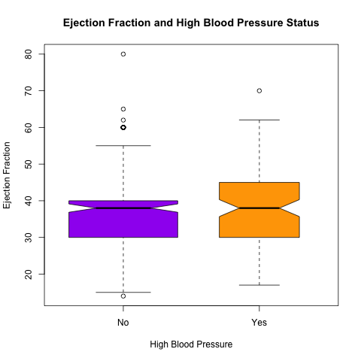
HF Dataset Visualization of key clinical and demographic characteristics characteristics

Slide 7

Visual Data and Statistics Analyzer Purpose and Interface
Purpose
Provide a platform of quick summary statistics of both numerical and categorical variables
Facilitate a quick construction of Table 1 for publication
Create regression plot for quick visualization of numerical variables by a categorical variable
Without having the user to write codes
Interface
Allow user to upload a “csv” file
Provide a dropdown menu for variable inputs
Converse numerical data to categorical data as needed

Slide 8
Visual Data and Statistics Analyzer Facilitate Creation of “Table 1”
Table 1. Baseline Demographics and Clinical Characteristics of Patients with Class III and IV Heart Failure (N= 299)
Parameters | Mean (SD) Median (range)
Age (yr) | 60.00 (11.89) 60.83 (40, 95)
Gender (male), n (%) | 194 (64.88)
Anaemia, n (%) | 129 (43.14)
creatinine_phosphokinase | 581.8 (970.29) 250.0 (23, 7861)
ejection_fraction | 38.08 (11.85) 38 (14, 80)
serum_creatinine | 1.10 (1.03) 1.394 (0.5, 9.4)
serum_sodium | 136.6 (4.41) 137.0 (113, 148)
platelets | 263358 262000 (25100, 850000)
high_blood_pressure, n (%) | 105 (35.12)
Diabetes, n (%) | 125 (41.81)
Smoker, n (%) | 96 (32.10)
Time to death | 130.3 (77.6) 115.0 (4.0, 285.0)
Death | 96 (21.10)

Slide 9
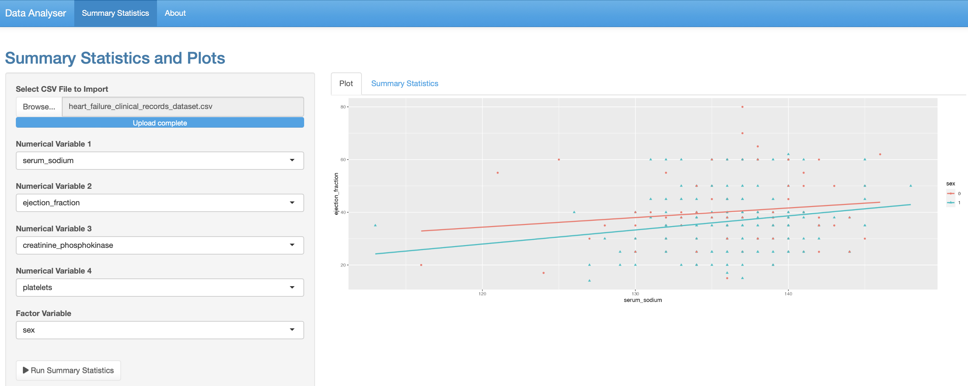
Visual Data and Statistics Analyzer Outputs- Simple Linear Regression Plot by Factor

Slide 10
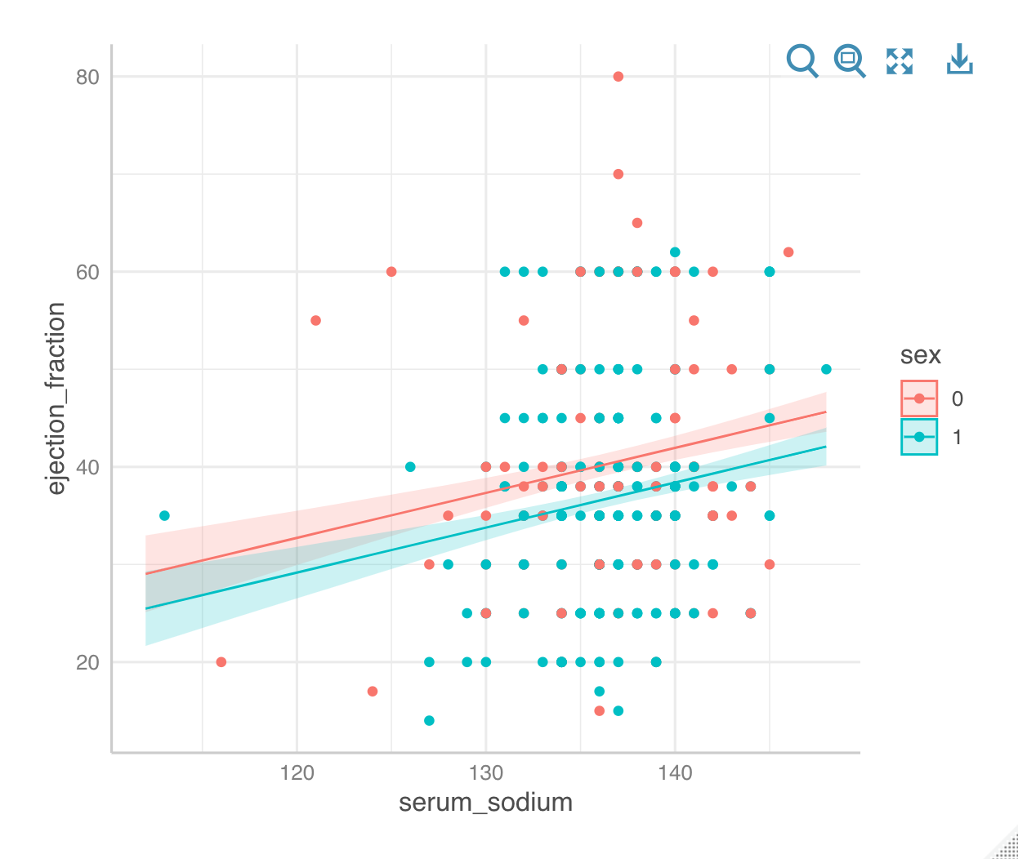
Visualization of the final, interactive ANCOVA model from the HF dataset
By applying visualization plot, we could create an interactive ANCOVA model based on the HF dataset.

Slide 11
References
The original codes are from https://towardsdatascience.com/how-to-build-a-data-analysis-app-in-r-shiny-143bee9338f7.
https://github.com/PY1028/School-Project.git

